Slide 1
Online Job Portal
Submitted by:
Anju Kunjumon

Slide 2
ABSTRACT
This project is aimed at developing an online search Portal for the Placement Details for job seekers. The system is an online application that can be accessed throughout the organization and outside as well with proper login provided. This system can be used as an Online Job Portal for job seekers. Job Seekers logging should be able to upload their information.
This project is about the recruitment process which is done online. The recruitment process here is handled by the system. This project will allow the person to apply for a job in the company for the interested vacancy which would be available at the company.
The person will be having the account after registration and will be then called the applied user. If he would be qualified, he would be interacting with the system for the updates.

Slide 3
The project is created for fulfilling the requests of the company managers so that the recruitment module can be placed in the company’s website and the users who visit the website can view the vacancies in the company and will be able to apply directly from remote place even.
This project plays main role at admin side for recruitment process. The start dates and end dates for applications’ acceptance, the grace period, the job vacancies’ postings, modifying the privileges etc. are the special features of this system.

Slide 4
Module description
There are mainly 3 modules in our project
1.Admin
2.Company
3.job seeker

Slide 5
1. Admin
In this module Admin will add all the qualifications, skill, experience, city, state, country and update and delete information about the job provider or job seeker he can also search for the job seeker and he can send mail to offer the job to job seeker and he can also see the jobs add by the job provider.
2.Company
Company can register in the system, show vacancies, they can select eligible students based on the cv, guest can visit and register the system, company can view the applied candidates and can approve or reject the application.

Slide 6
Job seeker
In this module Job Seeker register him self and upload his resume and fill the profile give by admin and after login he will search for the job on various conditions and he can change his profiles and resume and he can apply for the jobs based on various conditions. He can see the response of the company and he can call the company person for the interview

Slide 7
About
Our topic is “Online Job Portal”. The purpose of Job portal System is a software application that can be used to register Job seekers, company. Using this system company can display their vacancies, approve application of candidates. candidates can view and register their preference.
We are doing our project in JSP. Building tools are :
Glass fish
Netbeans
GITHub

Slide 8
EXISTING SYSTEM
Our existing system is work fully manually.
In a manual system Jobseeker can all work on paper so it is very time consuming process.
When new member are include then paper work will be automatically increased.
All job search manually because the company are connected will admin.
The Jobseeker who want to apply for specific Job . it’s hard to find as per specification.

Slide 9
PROPOSED SYSTEM
Application will provide the seprate user account which are used to upload resume,
update profile and apply for multiple job.
Provide easy and quick search of job from this application.
This application provide user on criteria that is alone by specifice user account.
User can update profile and resume for different types of job category.

Slide 10
TABLE DESIGN
TABLE NAME: tbl_login
Field Name | Data Type | Constaints
id | Int | Primary key
username | Varchar | Null
Email_id | varchar | null
password | varchar | null
2.TABLE NAME: tbl_location
Field name | Data Type | Constraints
id | Int | Primary key
location | varchar | Null

Slide 11
3. TABLE NAME: tbl_skilllevel
Field name | Data Type | Constraints
Slevel_id | Int | Primary key
Skilllevel | varchar | null
4. TABLE NAME: tbl_additionaldetails
Field name | Data Type | Constaints
id | int | Primary key
userid | int | foreign key
adddetails | varchar | null

Slide 12
5.tbl_ edu
Field Name | Data Type | constaints
edu_id | Int | Primary key
userid | Int | Foreign key
did | Int | Null
college | Varchar | Null
stream | Varchar | Null
syear | date | Null
eyear | date | Null
percentage | Int | Null

Slide 13
6. TABLE NAME: tbl_jobdetails
Field Name | Data Type | Constaints
id | Int | Prmary key
organization | varchar | Null
location | Varchar | Null
syear | Varchar | Null
eyear | Varchar | Null
description | Varchar | Null
userid | Varchar | Null

Slide 14
7. TABLE NAME: tbl_jobdetails
Field Name | Data Type | constraints
Job_id | Int | Primry key
Job_name | Varchar | Null
Jobtype_id | Int | Foreign key
Job_basic | Int | Null
Job_novaccancy | Int | Null
Company_id | Int | Foreign key

Slide 15
8.TABLE NAME: tbl_personaldetails
Field Name | Data type | Constaints
id | Int | Primary key
tittle | Varchar | Null
name | Varchar | Null
Country_code | Int | Null
phone | Int | Null
city | Varchar | Null
city1 | Varchar | Null

Slide 16
9. TABLE NAME: tbl_education
Field Name | Data Type | Constaints
e_id | Int | Primary key
degee | Varchr | Null
degreetype | Varchar | Null
11. TABLE NAME: tbl_oranization
Field Name | Data Type | Constraints
id | Int | Primary key
oid | Int | Null
oname | Varchar | Null
uname | Varchar | Null
password | Varchar | Null
emailid | Varchar | Null

Slide 17
12. TABLE NAME: tbl_organization2
Field Name | Data Type | Constraints
id | Int | Primary key
oid | Int | Foreign key
address | Varchar | Null
aboutfirm | Vrchar | Null
contactno | Int | Null
web | varchar | Null
13. TABLE NAME: tbl_result

Slide 18
14 TABLE NAME: tbl_ propic
Field Name | Data Type | Constraints
userid | Int | Primary key
picaddress | Varchar | Null

Slide 19
UML Diagram
View Vacancy
Apply Job
Add preference
Manage details
View email
Approve
Jobseeker
company
Admin
Login
Post Jobs
Compan
View registered
y
users
Accept usersrs

Slide 20
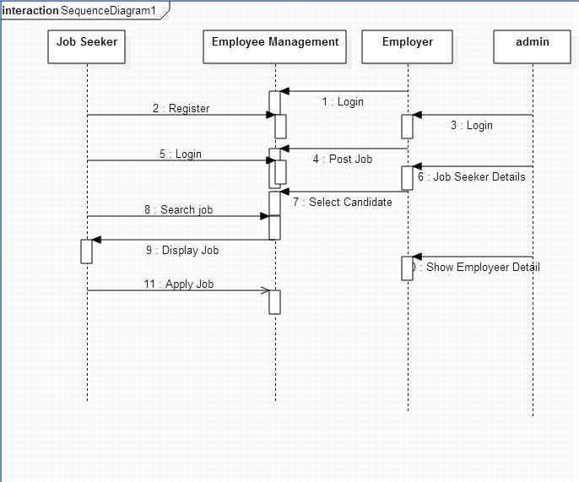
Sequence diagram

Slide 21
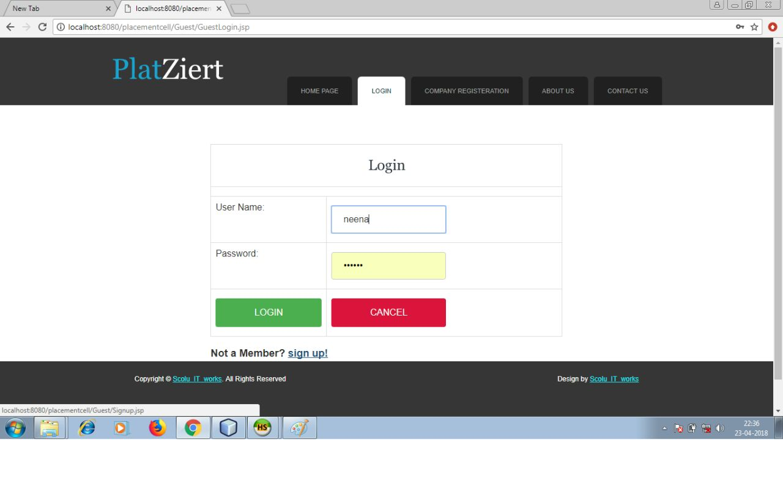
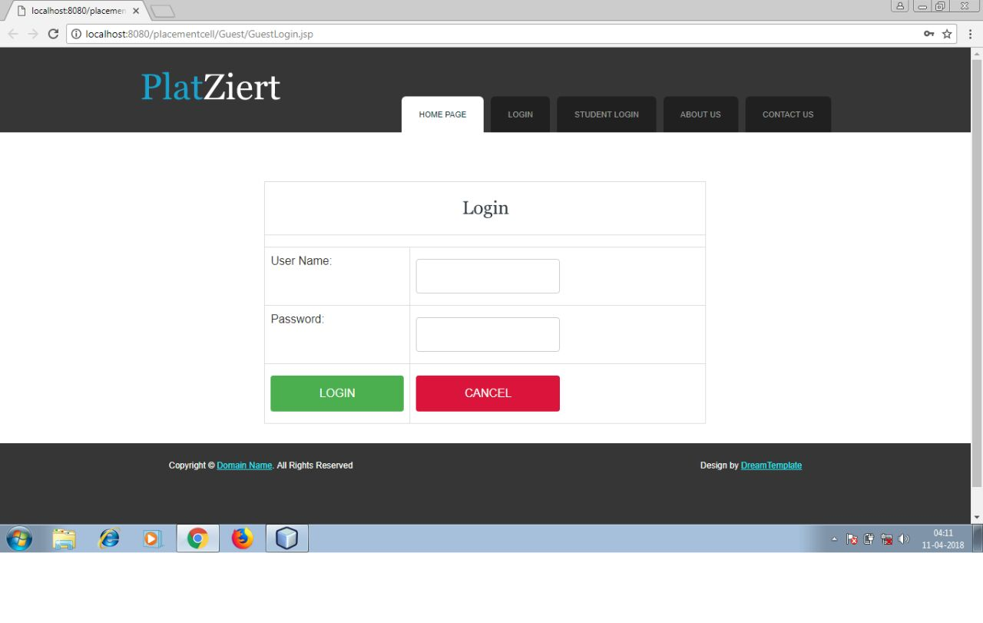

Slide 22
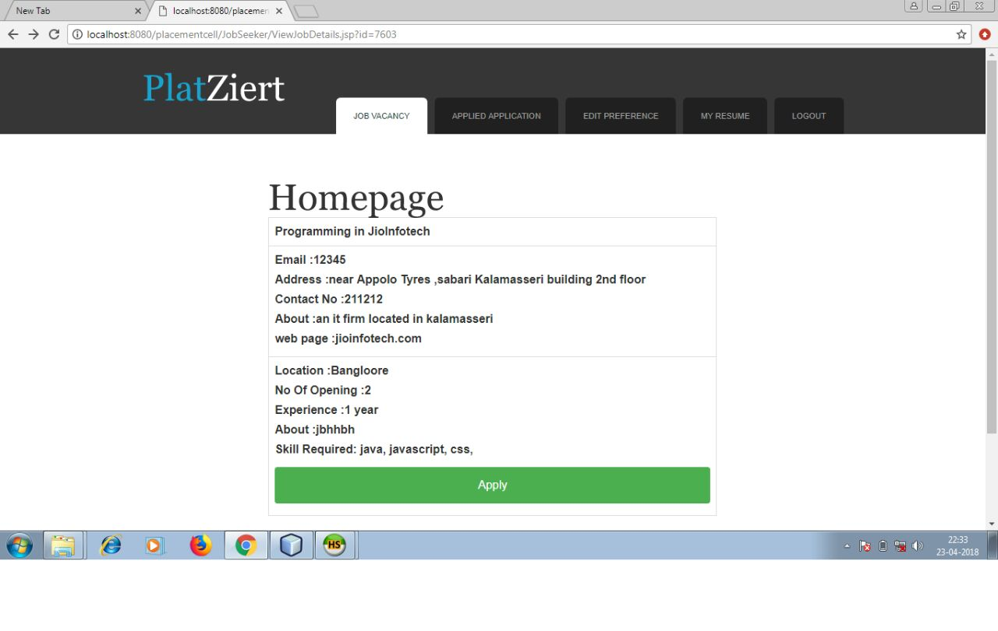

Slide 23
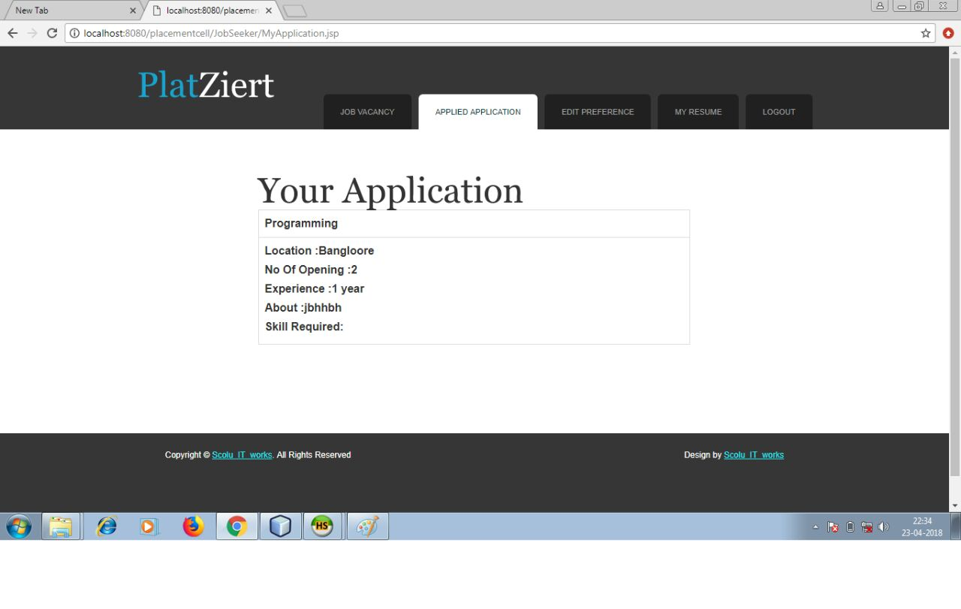

Slide 24
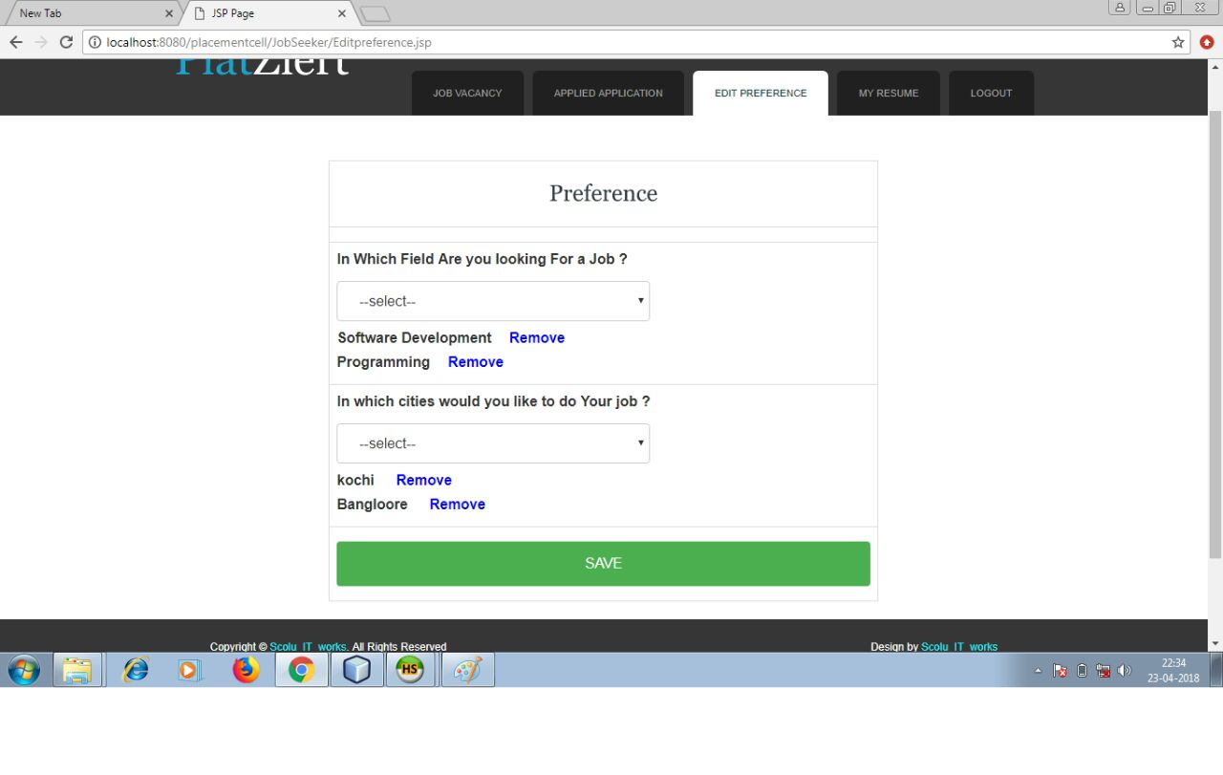

Slide 25
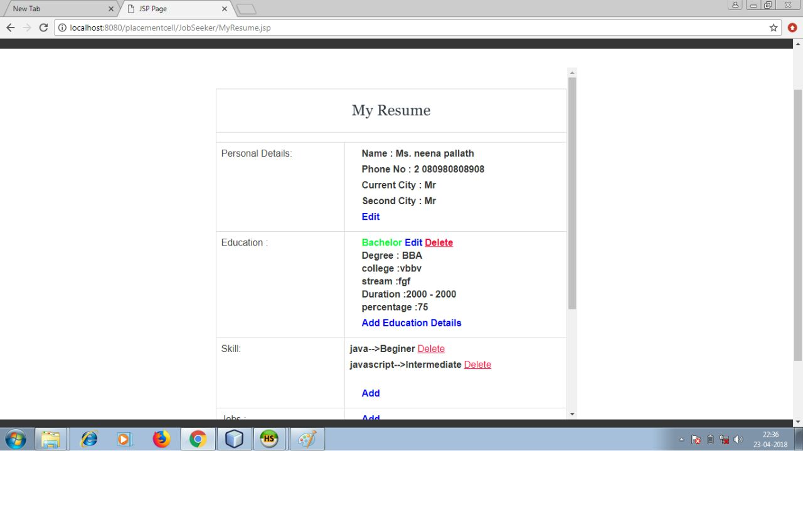

Slide 26
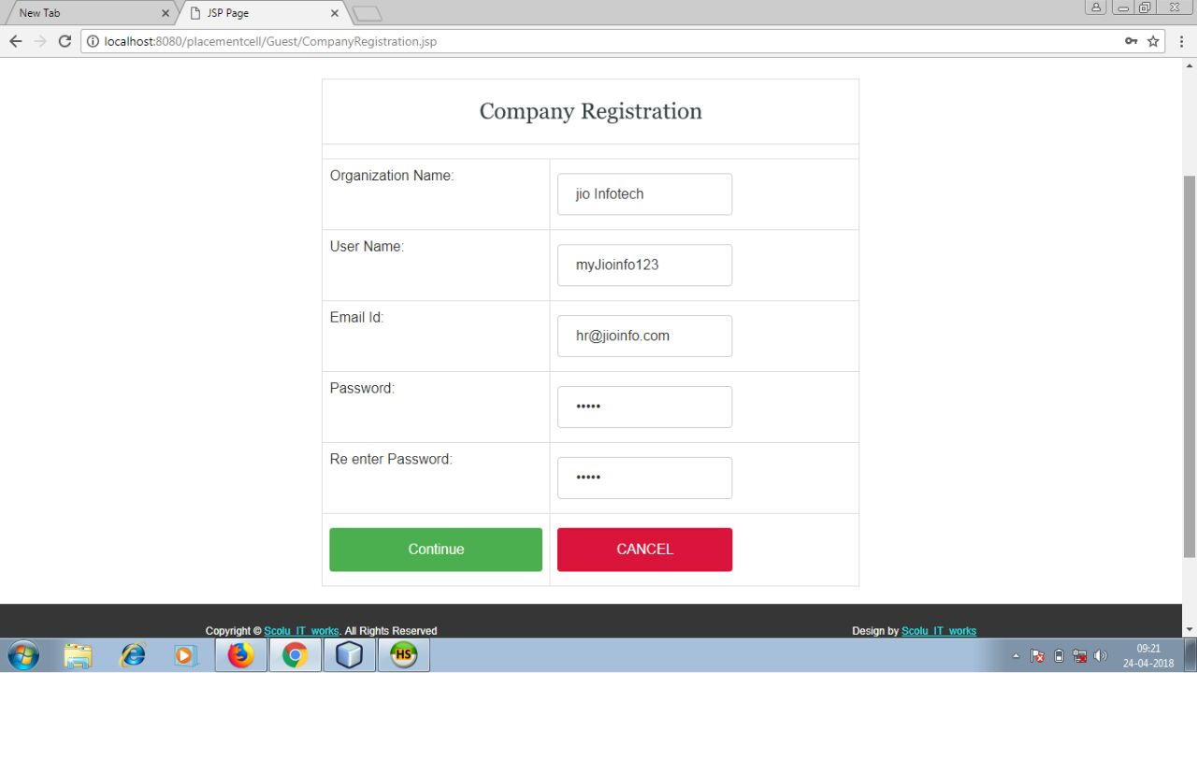
company Registration

Slide 27
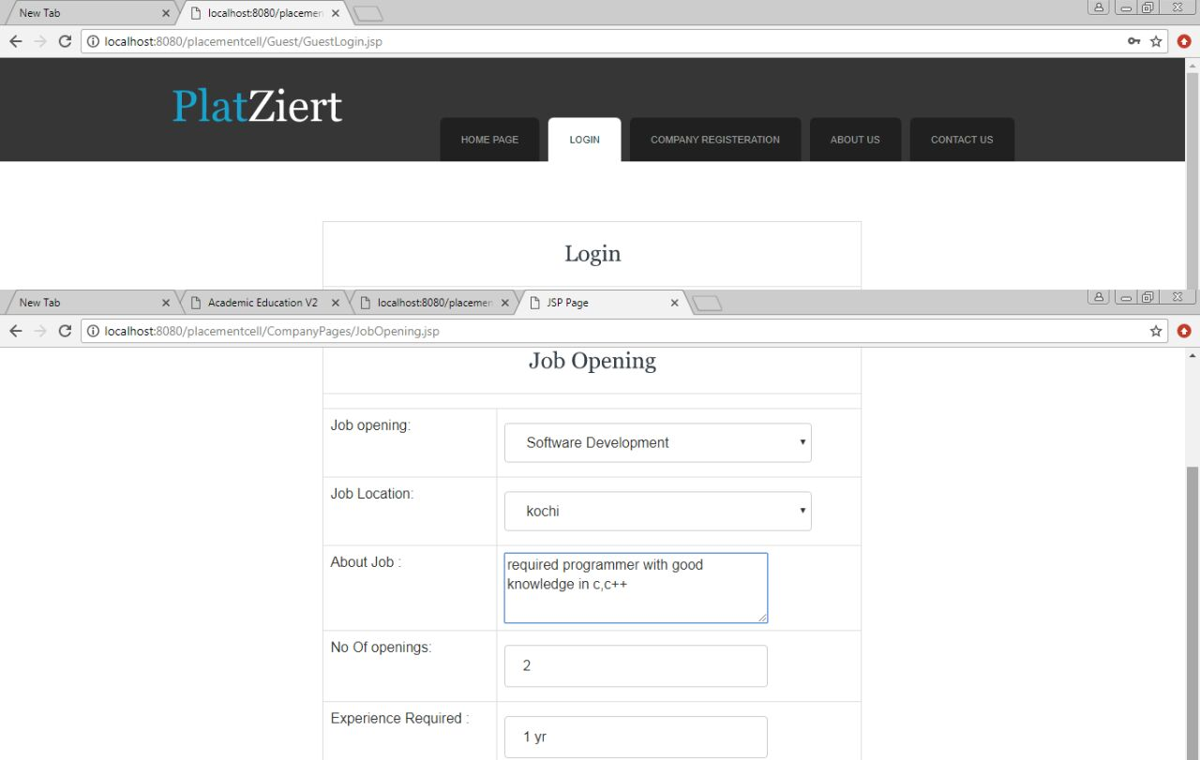
Job opening

Slide 28
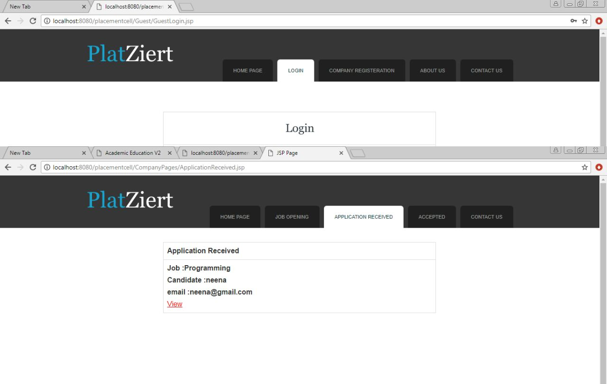

Slide 29
